Slide 1
OCA – Java SE 8 Programmer Java Essentials – part 1
OCA – Java SE 8 Programmer

Slide 2
Learning Objectives
Welcomes
VLE
OneFile
IDE
Java Basics
Define the scope of variables
Define the structure of a Java class Create executable Java applications with a main method; run a Java program from the command line; including console output
Import other Java packages to make them accessible in your code

Slide 3
THE OCA 8 EXAM
While the exam tends to have between 60-70 and a time period of 90-150 minutes you are expected to gain 65% to PASS
The format of the exam is multiple choice questions
There are 2 exams for the Oracle :
OCA Java SE 8 Programmer I 1Z0-808 Exam
Focusses on the Java language
OCP Java SE 8 Programmer II 1Z0-809 Exam
Covers Java technologies

Slide 4
OCA Java SE 8 Programmer I 1Z0-808 Exam
Exam Contents
Java Basics
Working with Java Data Types
Using Operators and Decision Constructs
Creating and Using Arrays
Using Loop Constructs
Working with Methods and Encapsulation
Working with Inheritance
Handling Exceptions
Working with Selected Classes from the Java API

Slide 5
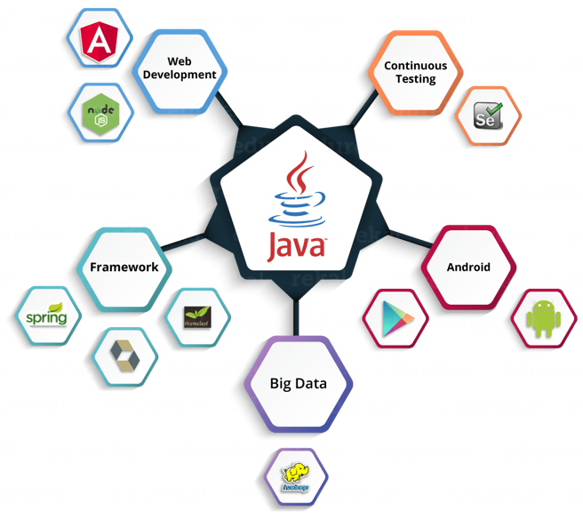

Slide 6

What do you need?
IDE – IntelliJ IDEA from JetBrains
https://www.jetbrains.com/idea/
VLE Course
https://vle.estio.co.uk/course/view.php?id=730
Practice exams
use https://webets-server-aws.enthuware.com/webets.html - and the code given to you by your trainer.

Slide 7
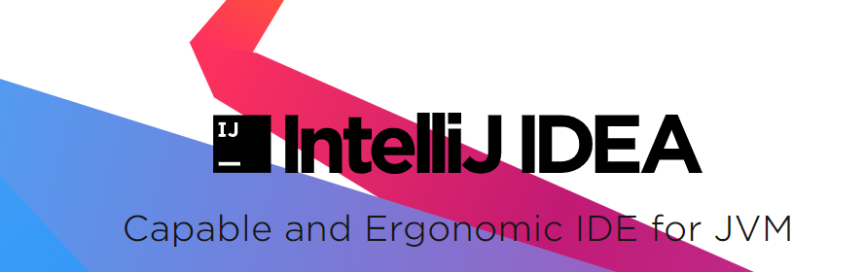
Getting Started… Hello World!
Open up IntelliJ. Installation instructions
We are going to create the traditional ‘Hello World’ program.
An online alternative to this is REPL.IT
Open this up and be sure you can make create your program

Slide 8
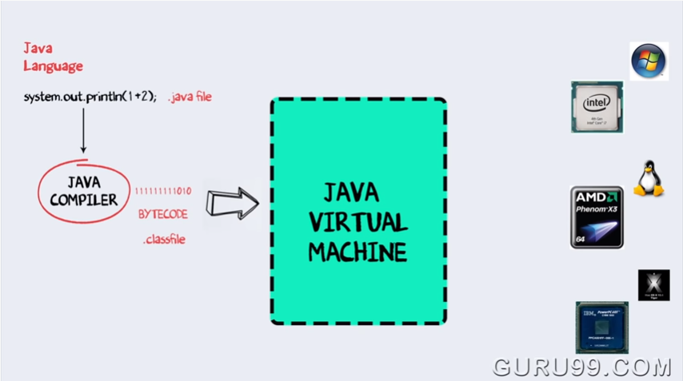
Programming Languages RECAP & Intro to JAVA
https://www.youtube.com/watch?v=2Xa3Y4xz8_s

Slide 9
WORA
The Java language is described as WORA (Write Once, Run Anywhere). This means that compiled Java code can be run across all platforms without the need for recompiling.
This is possible because Java programs are compiled down to an intermediary, platform-independent language called bytecode.
A software component called the JVM (Java Virtual Machine) is able to take the bytecode and run it on each individual platform (i.e. convert to native machine code compatible with each particular platform).
READ the handout named ‘READ ME – Introduction to Java.pdf’

Slide 10
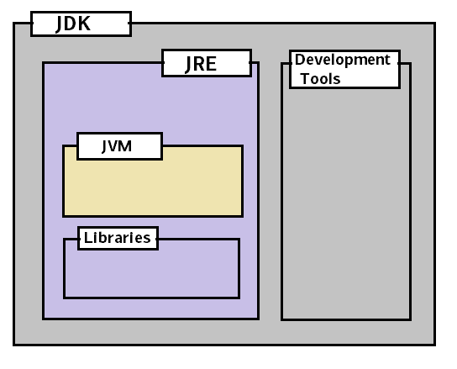
The JRE and JDK
On each platform where you intend to run java, the JRE (Java Runtime Environment) must be installed.
The JRE consists of the Java Virtual Machine (JVM), Java platform core classes, and supporting Java platform libraries (basically everything you need to run java programs).
Alternatively, software developers can install the JDK (Java Development Kit) which consists of the JRE plus additional developer tools such as a compiler.
Notes:
https://stackoverflow.com/questions/1906445/what-is-the-difference-between-jdk-and-jre

Slide 11









Benefits of Java
Object Oriented
Reusable Code - via inheritance
Modular – better troubleshooting and maintenance
Flexibility – allow adaptability of use via polymorphism
Problem Solving – being able to break and define real world items easily
Encapsulation
Security by Design – by using access modifiers to protect data
Secure Platform Independence
Java is interpreted (via compiled bytecode) by the Java Virtual Machine
The JVM allows code to run on any operating system – Write once Run anywhere
Secure - The JVM protects the devices it runs on by stopping direct access to it.
Robust & Simple
Java manages its own memory avoiding memory leaks making it simpler than other languages that require manual memory management.

Slide 12
Variables & Data Types - Java Basics & Working with Java Data Types
Data Types
Variables are names for areas of memory that store data
This allows us to perform operations on that data
The Java compiler (javac) scans the sources code checking the data type compatibility with the proposed operations on them.
This is what you would expect from a strongly typed language like Java, it stops run time errors.
A data type tells how much we can store in a variable

Slide 13













Primitives, Classes & Reference Types
Primitives are the name we give to a certain type of data type.
They are called primitives because they are the fundamental types that Java uses.
Examples of Primitive data types are: int, char, float and Boolean
All primitives are stored in a area of memory called the Stack
Objects are useable collections of Data and Functions they are instantiated or created from Classes (templates)
Objects are stored on the Heap and are pointed to by reference types
Notes:
Primitives are kept in the stack, they are always lower case.
Heap is where objects and other reference are allocated. If you are calling from an object it will not reallocate memory but will continue to overwrite the existing object value.

Slide 14
Data Types or Primitives
Data Type | Size | Description
byte | 1 byte | Stores whole numbers from -128 to 127
short | 2 bytes | Stores whole numbers from -32,768 to 32,767
int | 4 bytes | Stores whole numbers from -2,147,483,648 to 2,147,483,647
long | 8 bytes | Stores whole numbers from -9,223,372,036,854,775,808 to 9,223,372,036,854,775,807
float | 4 bytes | Stores fractional numbers. Sufficient for storing 6 to 7 decimal digits
double | 8 bytes | Stores fractional numbers. Sufficient for storing 15 decimal digits
boolean | 1 bit | Stores true or false values
char | 2 bytes | Stores a single character/letter or ASCII values

Slide 15

Primitives & Reference Types vs Objects
Primitives are stored on the Stack
What is the Stack? - Primitives
The Stack is an area of Memory where Primitive and Reference Variables are stored
They use a LIFO mechanism to be removed from the stack.
This is considered organised memory.
Objects are stored on the Heap.
Objects are instantiated Classes and have reference type variables pointing to them.
Reference variables are stored on the Stack and point to Objects the Heap - Reference Types
It is unordered i.e. randomly accessed or removed, therefore it is unorganised

Slide 16
CLASSES
For example, you might have a Car class that describes the features of all cars (has wheels and an engine, drives, etc). This is equivalent to the designs and blueprints created by engineers and car designers.
The Car class serves as an abstract model for the concept of a car — to drive, or interact with, or stop a car you must create a concrete instance of that car. i.e. you must create a real car (an object) from the designs

Slide 17
Class Example - creating a Box
Lets take a Square Box! Think what do squares share in common?
Width.
In a square, width is the same as height.
What can we do with a square box?
Set the width .
Get the width.
Get the area.
W x W = W²
These are properties
These are methods – Things that our box can do
width
width

Slide 18

From this basic Class, we can now make an actual Box!
w
w
Box Class
New Box
New Rectangle
w
h
Box:
Properties : width
Methods : setWidth
: getArea
Rectangle:
Properties : width
Height
Methods : setWidth
setHeight
getArea
New Triangle
Triangle:
Properties : width
Height
Methods : setWidth
setHeight
getArea
h
d
3D Rectangle:
Properties :Width
Height
Depth
Methods : setWidth
setHeight
setDepth
getVolume
w
New 3D Box/Rectangle

Slide 19





The Power of Object Orientated Programming.
Classes – Let you provide a blueprint/outline of an idea.
Objects – Create an actual instance of the class

Slide 20
*** TASK ***
Let’s create a Car class in a new Java program.
Create a new program named ‘OOP’. You should use the Command Line App’ template.
Right-click on the ‘src’ folder and Add a new Java class – named Car.
If there is a sub-folder within ‘src’ (such as com.company), create your class in there!
Inside this class you should add some variables that will store the data describing your car – these will be your attributes.
You should also add some methods/functions that give your Car class some behavior it can perform.
See the next slide for examples!

Slide 21
Car class - example
public class Car
{
//attributes
String make;
String model;
int numberOfDoors;
//methods (functions)
public void DescribeCar()
{
System.out.printf("Make: %s, Model: %s, with %d doors.", make, model, numberOfDoors);
}
// Can you think of any more methods to add?
}

Slide 22
MAKING OBJECTS….
The process of making an object from a class is known as INSTANTIATION. So called, because you are making an instance of a class.
Example:
Car is the name of your class.
myCar is the name you are giving to the object you are creating.
new Car() is the code to call a special method called a constructor and make a new car object in memory.
Car myCar = new Car();

Slide 23
MAKING OBJECTS….
Car myCar = new Car();
An instance of a class is another word for an actual object.
Remember: if classes are an abstract representation of an object, an instance is its concrete representation.
Memory is allocated for the object and its data as defined in the class.
The main point of OOP is CODE RE-USE – once we have defined a class (template), we can use it to create and work with infinite objects of that type.

Slide 24
INSTANTIATION - example
e.g.
Dog rayne = new Dog();

Slide 25
3. Classname
2. Keyword
1. Classname
6. Constructor
Dog fido = new Dog();
4. Object name/ reference name
5. Assignment
 |  | Descriptions
1 | Classname | Class name we are trying to make?
2 | Keyword | New is a keyword we use to create a new instance of an object.
3 | Classname | We use this to select the class that is being instantiated, it can even be a sub class of the one in step 1.
4 | Object name | This is the name that we can refer to our new object by.
5 | Assignment | The single ‘=’ is the assignment operator in Java. ‘==’is a logical operator.
6 | Constructor | This is mandatory and should correspond with the arguments for the class to be required.

Slide 26
*** TASK ***
Use instantiation to make at least one car object from your Car class.
e.g. go to your ‘Main.java’ file, and inside the ‘main’ method, write code to instantiate an object.
Example
public class Main {
public static void main(String[] args)
{
// write your code here
//instantiation
Car myCar = new Car();
}
}

Slide 27
ENCAPSULATION
What is encapsulation?
Encapsulation = is the concept of wrapping data and methods together into the same component – the class.
Encapsulation = a mechanism for restricting access to some of the object’s components
We have already put all our Car attributes (data) and methods (behavior) into the same class, so we’ve achieved the first point above.
However, we need to look at the second point – restricting access.

Slide 28

ENCAPSULATION in JAVA
In Java, data stored in attributes/variables of a class should ALWAYS be hidden away so that code from other classes cannot access it and change it directly.
Imagine you have written a Calculator class, your calculator has got values it uses for calculations, such as Pythagoras, you would never want anyone who uses your Calculator class to be able to alter these such values, This would compromise the integrity of your application. So when creating applications, it’s sometimes necessary to control the way these fields are accessed. This is where encapsulation comes in.
The general rule is to do DATA HIDING – do not expose data to the outside world unless absolutely necessary!

Slide 29
ACCESS MODIFIERS
So, how do we hide data/attributes? We use ACCESS MODIFIERS (sometimes known as ACCESS SPECIFIERS).
Java supports the following access modifiers that you need to be aware of:
+ public (all code can access)
- private (only code in the same class can access)
# protected (only code in the same class or a derived class can access – more on this later.)

Slide 30
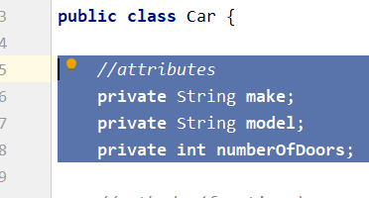
*** TASK ***
Go back to the code for your Car class.
Add the private access modifier to all of your attributes (variables).
This will mean that ONLY CODE INSIDE YOUR CAR CLASS CAN ACCESS THESE ATTRIBUTES!

Slide 31
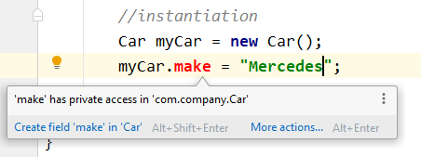
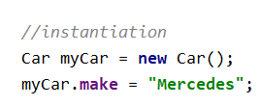
*** TASK ***
You can test the level of access out – if you go to your Main class (where you have instantiated an object), private attributes cannot be used on your car object, because you are coding in another class.
Try swapping the ‘private’ for ‘public’ and you should see the difference – as shown below!
vs

Slide 33
ENCAPSULATION – ACCESSING DATA
Best practice to achieve proper ENCAPSULATION and DATA HIDING in Java is to have all attributes (variables/data) marked as private. So what if we need to assign or update these data values outside of our class.
We have two ways:
Use a CONSTRUCTOR to initialise our data
Use GETTER and SETTER methods to allow access to our data

Slide 34
CONSTRUCTORS
As briefly already mentioned, when you write the line of INSTANTIATION, you are calling a special hidden method called a CONSTRUCTOR.
Every single class in Java has this special method hidden behind the scenes.
There are 4 important things you need to know about Constructors:
It is a method that runs at instantiation (i.e. when you are constructing an object from your class).
They have NO RETURN TYPE.
They are NAMED THE SAME AS THEIR CLASS.
The main use of constructors is to initialize your object’s data.
Car myCar = new Car();
Constructor

Slide 35
*** TASK ***
Let’s add a CONSTRUCTOR to our Car class – as shown below:
This constructor accepts 3 parameters, and uses the incoming values to INITIALISE our internal, private attributes (variables)
public class Car
{
//attributes
private String make;
private String model;
private int numberOfDoors;
// Constructor
public Car(String mke, String mdl, int numDoors)
{
this.make = mke;
this.model = mdl;
this.numDoors = numberOfDoors;
}

Slide 36
*** TASK ***
Now when you go back to your INSTANTIATION CODE, you should see that you MUST supply the two string and one int values.
This means that in one line you have created a car object AND initialized it’s data values! So in one line, your car object is ready to go!
Now you can call (invoke) any methods on your object…. TRY IT!
Car myCar = new Car("Mercedes", "SLK", 4);
Car myCar = new Car("Mercedes", "SLK", 4);
myCar.DescribeCar();

Slide 37
GETTER and SETTER METHODS
A constructor is very useful to set your attributes to their initial values – however it only runs once (at object instantiation).
We can create specific methods to allow your attribute data to be altered during the rest of the object’s life cycle.
These methods are known as GETTERs and SETTERS
Getters – are regular methods that return available the data value stored in attributes from within a class.
Setters - are methods that allow new data values to be passed in as parameters and assign new values to your attributes.
You can use Getters, Setters or both depending upon your needs! – The main advantage of them is you as the architect of your class can police how data is accessed or altered. Eg: if you were setting a VAT value, you could make sure the user doesn’t set a minus value.

Slide 38
GETTER and SETTER - examples
// Getter methos - This is public so it can be used by other classes/code
public String getMake()
{
return make;
}
// Setter method - this is also public, accepts incoming parameters
public void setMake(String make)
{
if(make == "")
{
// we have checked the string was not empty, if it was we can give it a value
make = "NOT SET";
System.out.println("Can't set value to empty string");
}
else
{
// if it's not empty, we can set the value
this.make = make;
}
}

Slide 39
*** TASK ***
Look at your Car code.
Add additional attributes that you feel would be needed for a Car. Ensure that these are private.
Where appropriate, create suitable ‘Getter’ and ‘Setter’ methods that are publicly exposed and allow the reading or re-assigning of some of your attributes.

Slide 40
Wrapper classes
Before we move on:
Java has a series of class called Wrapper Classes
They convert data types into objects
Why?
Certain packages in Java only handle objects
Collections (types of storage object) only store objects(reference types)
Multithreading and synchronization can only support objects too.
Wrapper Class will convert primitive data types into objects. The objects are necessary if we wish to modify the arguments passed into the method (because primitive types are passed by value).

Slide 41
Primitives & Wrapper Class Equivalents
Primitive Data Type | Wrapper Class
byte | Byte
short | Short
int | Integer
long | Long
float | Float
double | Double
boolean | Boolean
char | Character
The 8 Java Primitive data types and their corresponding wrapper classes

Slide 42

Program 1
public class Main {
public static void main(String[] args) {
// Primitive
long int1 = 100;
//Wrapper Class Long used to insatiate object int2
Long int2 = new Long(100);
//Print Output
System.out.println(int1);
System.out.println(int2);
//Use method GetClass on Output int2
System.out.println(int2.getClass());
}
}

Slide 43

Autoboxing & Unboxing
public class AutoBoxingTest
{
public static void main(String args[])
{
int num = 10; // int primitive
Integer obj = Integer.valueOf(num); // creating a wrapper class object
System.out.println(num + " " + obj);
}
}
Example
Code
OUTPUT: 10 10
public class UnboxingTest
{
public static void main(String args[])
{
Integer obj = new Integer(10); // Creating Wrapper class object
int num = obj.intValue(); // Converting the wrapper object to primitive datatype
System.out.println(num + " " + obj);
}
}
OUTPUT: 10 10

Slide 44

Primitives Revisited - Limitations
Data Type | Size | Description
byte | 1 byte | Stores whole numbers from -128 to 127
short | 2 bytes | Stores whole numbers from -32,768 to 32,767
int | 4 bytes | Stores whole numbers from -2,147,483,648 to 2,147,483,647
long | 8 bytes | Stores whole numbers from -9,223,372,036,854,775,808 to 9,223,372,036,854,775,807
float | 4 bytes | Stores fractional numbers. Sufficient for storing 6 to 7 decimal digits
double | 8 bytes | Stores fractional numbers. Sufficient for storing 15 decimal digits
boolean | 1 bit | Stores true or false values
char | 2 bytes | Stores a single character/letter or ASCII values
If you want to store larger numbers than the Primitive limits allow you will need to use specialist classes

Slide 45
Primitive Limitations – Numbers;
For numbers larger than the allowable limits described in for Java Primitive Data Types use the following classes:
BigInteger
BigDecimal
Both can be found in - java.math.* and access by including the following line in your code:
import java.math.*;
Note: more on this in a later:

Slide 46

Program 2
public class MyNewObject
{
//Start of Class definition
private String Name;
private int Val;
public MyNewObject(String name, int val)
{
//Constructor
Name = name;
Val = val;
}
public void displayName()
{
//Used below within the main method
System.out.println("Hi my name is:" + Name);
}
public static void main(String[] args)
{
MyNewObject mno = new MyNewObject("Object 1",1881); //Code from slide 9
mno.displayName(); //Code from slide 9
}
}

Slide 47
public class MyNewObject
{
//Start of Class definition
private String Name;
private int Val;
public MyNewObject(String name, int val)
{
//Constructor
Name = name;
Val = val;
}
public void displayName()
{
//Used below within the main method
System.out.println("Hi my name is:" + Name);
}
public int getValue()
{
return Val;
}
public static void main(String[] args)
{
MyNewObject mno = new MyNewObject("Object 1",1881);
mno.displayName();
System.out.println(mno.getValue());
}
}
Program 2
extended

Slide 48
Package Declaration
import java.lang.System; //redundant call
import java.lang.*; //redundant call
import java.util.Random;
import java.util.*; //redundant call
public class ImportExample
{
public static void main(String[] args)
{
Random r = new Random();
System.out.println(r.nextInt(10));
}
}
All packages are used via the import keyword
The package java.lang is imported automatically

Slide 49
Very large numbers
If you need to calculate numbers longer than 19 digits
Or of precisions greater than 15 digits
Then you should consider using BigInteger or BigDecimal
These objects take String representation of the numbers required
They have various methods for calculation including:
add, multiply, negate, remainder etc.

Slide 50
import java.math.*;
public class DataTypes
{
public static void main(String[] args)
{
double dVal = 111.222;
Double tempDv = 8827263535617818000.00073636388;
System.out.println("ff\t:" + String.valueOf(tempDv)+"\n");
BigDecimal bigD = new BigDecimal("8827263535617818000.00073636366");
System.out.println("bigD\t:" + bigD);
BigDecimal tempBd = new BigDecimal(String.valueOf(dVal));
bigD = bigD.add(tempBd);
System.out.println("bigD\t:" + bigD);
}
}
Program 3
static method

Slide 51
Package Declaration contd.
import java.nio.file.Paths; //option 1
import java.nio.file.Files; //option 1
// Import java.nio.file.*; //option 2
public class InputImports
{
public void read(Files files)
{
Paths.get("name");
}
}
Classes Files and Paths are both found in java.nio.file
Therefore the two options will work;

Slide 52
Package Declarations – That won’t work
import java.nio.*;
//NO GOOD – wildcard only matches CLASS names not FILES.
import java.nio.*.*;
//NO GOOD – Only Single wildcard’s allowed (at the end)
Import java.nio.file.Paths.*;
//NO GOOD – you cannot import METHODS only CLASSES

Slide 53
Naming Conflicts
Consider class Date this can be found in the following packages:
java.util.Date; // and
java.sql.date;
For the following code:
Public class Conflicts {
Date date;
// code………………
}

Slide 54
Naming Conflicts contd.
If you really need to use two classes of the same name you must fully qualify the class names:
import java.util.Date;
public class Conflicts
{
Date date;
java,sql.Date sqlDate;
}
OR
import java.util.Date;
public class Conflicts
{
java.util.Date date;
java,sql.Date sqlDate;
}

Slide 55
Packages
Create two folders
packagea
packageb
Then create the following files:
ClassA.java
ClassB.java
Program 4

Slide 56
// ClassA.java
package packagea;
public class ClassA
{
}
// ClassB.java
package packageb;
import packagea.ClassA;
public class ClassB
{
public static void main(String[] args)
{
ClassA a;
System.out.println("Got it");
}
}
Program 4

Slide 57
Exam and Code Snippets
Code may not include imports, especially if the question doesn’t involve them.
Code may also not be complete – Question example:
Does this compile? - Answer YES
However the next one will not compile!
6: public void method(ArrayList list){
7: if (list.isEmpty()) { System.out.println(“e”);
8: } else { System.out.println(“n”);
9: }}

Slide 58
Exam and Code Snippets contd.
Does this compile?
- Answer NO
The reason for this is that because the line numbers start at 1 we can assume this is a complete piece of code and that means there is an import statement missing:
1: import java.util.*; // REMEMBER ArrayList is found in java.util
1: public class LineNumbers {
2: public void method(ArrayList list){
3: if (list.isEmpty()) { System.out.println(“e”);
4: } else { System.out.println(“n”);
5: } } }

Slide 59
Summary Java Essentials – part 1
In this part we have covered
Overview of the OCA Exam
Benefit of Java
Objects and Classes
Variables and data types
Primitives & Wrapper classes
Packages & declarations

